Slide 1
Digital Portfolio
STUDENT NAME: Shraya. M
REGISTER NO AND NMID: 2428B0246 and A184EE1B6E1DA3F8E7840941E6FEF1A6
DEPARTMENT:BCS Computer Science With Data Analytics
COLLEGE: COLLEGE/ UNIVERSITY:Tirupur Kumaran College For Women/ Bharathiar University

Slide 2
TITTLE
my Teacher Digital portfolio

Slide 3


AGENDA
Problem Statement
Project Overview
End Users
Tools and Technologies
Portfolio design and Layout
Features and Functionality
Results and Screenshots
Conclusion
Github Link
3/21/2024 Annual Review

Slide 4

PROBLEM STATEMENT
today’s digital era, students often struggle with engagement, understanding, and application of mathematical concepts beyond traditional classroom methods. The challenge lies in creating an interactive, accessible, and student-centered learning environment that not only improves academic performance but also fosters critical thinking and real-world problem-solving skills.”

Slide 5

PROJECT OVERVIEW
A teacher is a professional who imparts knowledge, skills, and values to learners in a structured way. Teachers play a crucial role in shaping individuals and society by guiding students through academic subjects as well as personal development. They are not just educators, but also mentors, motivators, and role modedecision-making.

Slide 6

WHO ARE THE END USERS?
Students (Primary End Users) The main receivers of knowledge, skills, and values. They directly benefit from the teacher’s lessons, guidance, and mentorship 2. Parents & Families Indirect end users. They benefit when their children learn well, succeed in academics, and grow in character. 3. Schools/Institutions End users at an organizational level. A teacher’s performance improves the school’s reputation and results. 4. Society & Community Long-term end users. Educated students contribute positively to society, so the impact of teachers reaches everyone. 5. Future Employers Indirect end users. Companies and industries rely on well-educated, skilled graduates shaped by teachers.

Slide 7

TOOLS AND TECHNIQUES
Tools (What teachers use) Digital Tools → Smart boards, Google Classroom, MS Teams, Zoom Traditional Tools → Blackboard, Chalk/Markers, Textbooks Assessment Tools → Quizzes, Tests, Online Forms Creative Tools → Flashcards, Charts, Educational Apps Techniques (How teachers teach) Lecture Method → Explaining concepts clearly Interactive Method → Group discussions, Q&A sessions Activity-Based Learning → Projects, experiments, role play Technology-Enhanced Learning → Videos, simulations, e-learnin

Slide 8
POTFOLIO DESIGN AND LAYOUT
Header: Name, subject, photo, tagline About: 3–4 lines (philosophy + goals) Skills & Tools: Bullet list (teaching + digital) Experience & Achievements: Roles, years, key wins Samples: Lesson plans/projects, student outcomes Certificates: Courses, workshops Contact: Email, phone, LinkedIn
8

Slide 9
FEATURES AND FUNCTIONALITY
Teacher – Features & Functionality Features: Knowledgeable, patient, good communicator, disciplined Functionality: Teaches, guides, evaluates, mentors, builds values

Slide 10
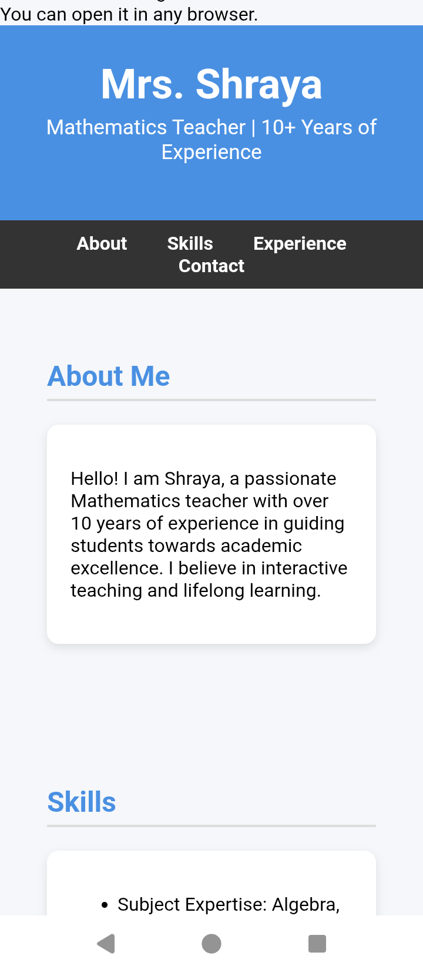

RESULTS AND SCREENSHOTS
3/21/2024 Annual Review
10

Slide 11
CONCLUSION
A teacher is not just an instructor but a guide, mentor, and role model who shapes the future of students and society. With knowledge, patience, and dedication, teachers inspire learning, build character, and create responsible citizens. ---
11

